Slide 1
Hinge Loss, Support Vector Machines and the Loss of Users
Andreas Maier, Vincent Christlein, Tobias Würfl, Katharina Breininger, Shahab Zarei
Lehrstuhl für Mustererkennung (Informatik 5),
Friedrich-Alexander-Universität Erlangen-Nürnberg, Germany

Slide 2
Hinge Loss, Support Vector Machines, and the Loss of Users
Hinge Loss
Support Vector Machines
Loss of Users
Outlook

Slide 3
Loss Function
Tells a network the merit of its output

Slide 4
Hinge Loss
Accepts correct output equally
Punishes misclassification in a linear fashion

Slide 5
Hinge Loss, Support Vector Machines, and the Loss of Users
Hinge Loss
Support Vector Machines
Loss of Users
Outlook

Slide 6
Support Vector Machines

Slide 7
Support Vector Machines – Hard Margin
Lagrangian formulation:
Karush-Kuhn-Tucker conditions:
Complementary Slackness

Slide 8
Support Vector Machines – Hard Margin
Equivalent formulation:
Using complementary slackness:
Hinge Loss!

Slide 9
Support Vector Machines – Soft Margin
Choose slack variables as:
Simplified optimization problem:
Equivalent to hard margin with

Slide 10
Support Vector Machines – Observations
Soft margin support vector machines can be formulated with hinge loss
Duality and notion of support vectors are lost
Integration into deep networks is easy
Read details in Vincent Christlein‘s PhD Thesis [1]

Slide 11
Hinge Loss, Support Vector Machines, and the Loss of Users
Hinge Loss
Support Vector Machines
Loss of Users
Outlook

Slide 12
Loss of Users [2]

Slide 13
Loss of Users [2]
Experts can pick one choice:
The other choices in Frame s are sub-optimal

Slide 14
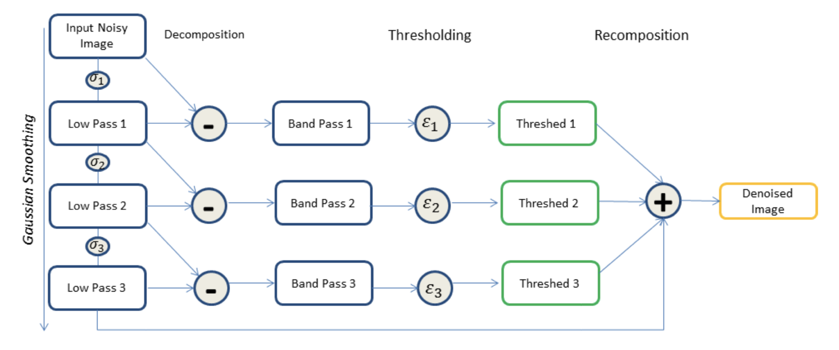
Loss of Users [2]
Will only work with few parameters
Here Precision Learning [3] approach to Laplacian Pyramid Filter

Slide 15
Loss of Users [2]
Net needs to mimick the ideal image:
Three constraints per click:

Slide 16
Loss of Users
Constraint only loss function:
Best-case only loss function:
Hybrid loss:
Any similarities with SVM?

Slide 17
Loss of Users – Results – User1

Slide 18
Loss of Users – Results – User1 vs User2
User1
User2

Slide 19
Summary
Hinge Loss
Support Vector Machines
Loss of Users
More Results in [2]

Slide 20
Thank you for your attention!
[1] Vincent Christlein. Hand-written Document Analysis with Focus on Writer Identification and Writer Retrieval. PhD Thesis. Friedrich-Alexander-University Erlangen-Nuremberg, 2018.
[2] Shahab Zarei, Bernhard Stimpel, Christopher Syben, Andreas Maier. User Loss - A Forced-Choice-Inspired Approach to Train Neural Networks directly by User Interaction. Under Review. https://arxiv.org/abs/1807.09303
[3] Andreas Maier, Frank Schebesch, Christopher Syben, Tobias Würfl, Stefan Steidl, Jang-Hwan Choi, Rebecca Fahrig. Precision Learning: Towards Use of Known Operators in Neural Networks. International Conference on Pattern Recognition ICPR 2018 (to appear). https://arxiv.org/abs/1712.00374

